Slide 1
DL2.0 Bootcamp CNNs for Text
By Kingsley Kuan

Slide 2
CNNs in Other Dimensions
3D CNN - Sliding window over 3D data
eg. Volumetric data (width, height, depth)
2D CNN – Sliding window over 2D data
eg. Image data (width, height)
1D CNN – Sliding window over 1D data
Eg. Temporal data (data over time)

Slide 3
Text Representations
How do we represent sentence text as a matrix?
“I stayed at Marina Bay Sands last weekend”
Words can be indexed into a one-hot vector
Results in sparse vectors
Convert words into word embeddings using Word2Vec, GloVe, etc

Slide 4
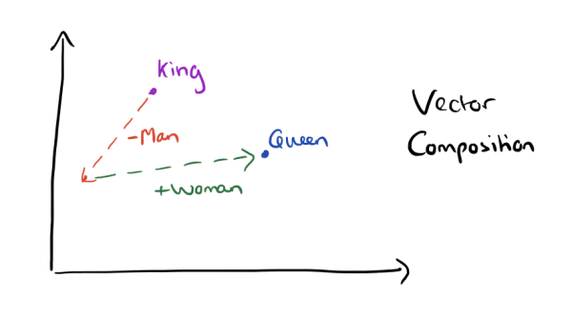
Word Embeddings
Word embedding models allow text to be embedded / represented in vector space
Similar words are located closely together in vector space
Word embeddings capture syntactic and semantic regularities, allowing algebraic operations.
Eg.
King – Man + Woman
= Queen
Useful starting point for Text CNNs!

Slide 5
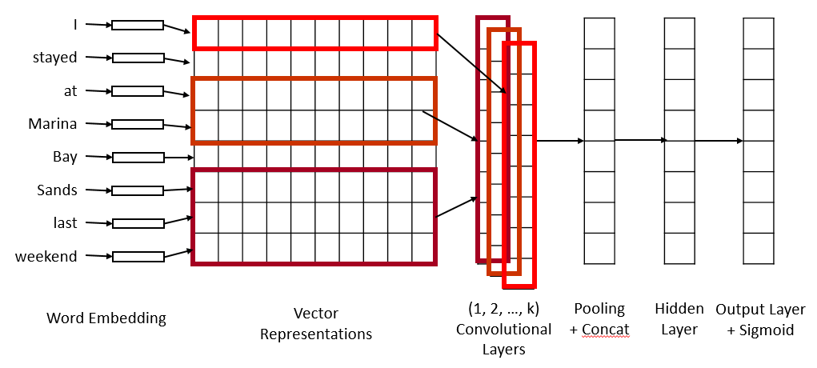
Text CNNs
Convert sentences into n x 300 matrices using Word2Vec
Slide convolutions across the temporal dimension
Notice that we use multiple convolutions of different filter sizes in parallel
Similar to n-gram
Temporal Dimension (n)

Slide 6
Text CNNs
n x 300 -> n x k x 512
where k is the number of parallel convolutions
Max pool across temporal dimension n and concatenate across k -> (k x 512) vector
Temporal Dimension (n)

Slide 7
Text CNNs
Fully connected hidden layer
Fully connected output layer
Softmax for mutually exclusive classes
Sigmoid otherwise
Temporal Dimension (n)

Slide 8
Code Walkthrough
Applying Text CNNs to YouTube Titles

Slide 9
References
Mikolov, Tomas, Wen-tau Yih, and Geoffrey Zweig. "Linguistic regularities in continuous space word representations." hlt-Naacl. Vol. 13. 2013. http://www.aclweb.org/anthology/N13-1090
Mikolov, Tomas, et al. "Efficient estimation of word representations in vector space." arXiv preprint arXiv:1301.3781 (2013). https://arxiv.org/pdf/1301.3781.pdf
Kim, Yoon. "Convolutional neural networks for sentence classification." arXiv preprint arXiv:1408.5882 (2014). https://arxiv.org/pdf/1408.5882.pdf

